Slide 1
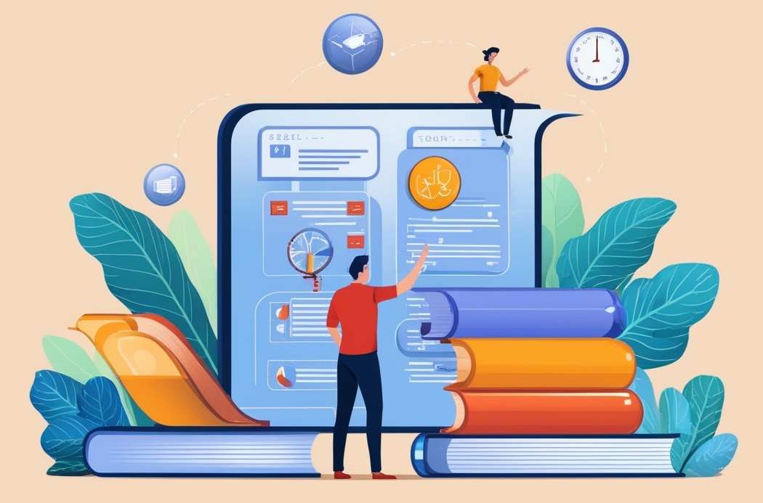
DESIGN AND ANALYSIS OF ALGORITHMS
Dr. Kashif Ayyub

Slide 2
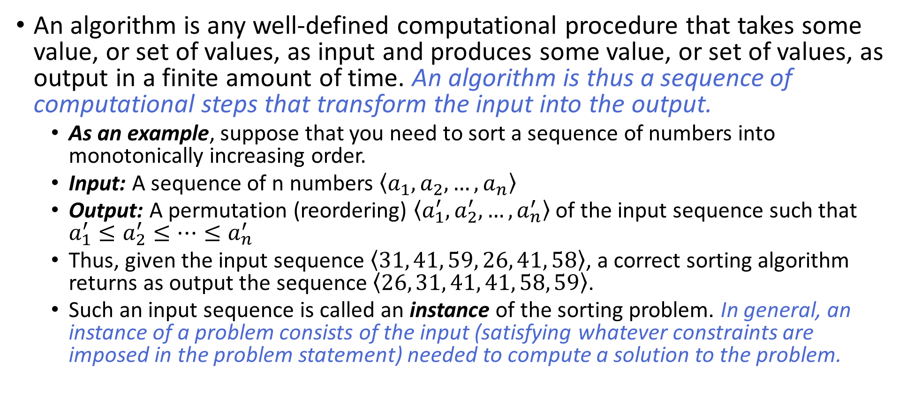
What are Algorithms
An algorithm is any well-defined computational procedure that takes some value, or set of values, as input and produces some value, or set of values, as output in a finite amount of time. An algorithm is thus a sequence of computational steps that transform the input into the output.
As an example, suppose that you need to sort a sequence of numbers into monotonically increasing order.
Input: A sequence of n numbers $\left\langle a_{1},a_{2},…,a_{n}\right\rangle$
Output: A permutation (reordering) $\left\langle a_{1}^{′},a_{2}^{′},…,a_{n}^{′}\right\rangle$ of the input sequence such that $a_{1}^{′}≤a_{2}^{′}≤…≤a_{n}^{′}$
Thus, given the input sequence $\left\langle 31, 41, 59, 26, 41, 58\right\rangle$, a correct sorting algorithm returns as output the sequence $\left\langle 26, 31, 41, 41, 58, 59\right\rangle$.
Such an input sequence is called an instance of the sorting problem. In general, an instance of a problem consists of the input (satisfying whatever constraints are imposed in the problem statement) needed to compute a solution to the problem.

Slide 3
What are Algorithms
An algorithm for a computational problem is correct if, for every problem instance provided as input, it halts (finishes) its computing in finite time and outputs the correct solution to the problem instance.
A correct algorithm solves the given computational problem.
An incorrect algorithm might not halt at all on some input instances, or it might halt with an incorrect answer.
Contrary to what you might expect, incorrect algorithms can sometimes be useful, if you can control their error rate. E.g. Code to find minimum number.
Wouldn't stop if replaces with “false”
std::cout << "Enter a list of numbers (enter 0 to finish): ";
std::cin >> min_num;
while (true)
{
std::cin >> num;
if (num == 0) break;
if (num < min_num) min_num = num;
}
std::cout << "The minimum number is: " << min_num;
Will generate wrong output if replaces with “>”

Slide 4
Why Do You Need to Study Algorithms
Foundation for Programming: Algorithms are fundamental to computer science and programming, providing a basis for understanding how software operates and how to build efficient systems.
Problem-Solving: Algorithms provide a structured approach to solving complex problems efficiently and effectively.
Efficiency: Understanding algorithms helps in designing solutions that are both time and resource-efficient, leading to faster and more reliable software.
Optimization: Knowledge of algorithms allows for optimizing code and improving the performance of applications by selecting the most appropriate algorithm for a given task.

Slide 5
Why Do You Need to Study Algorithms
Data Handling: Algorithms are crucial for managing and processing large amounts of data, including sorting, searching, and manipulating data structures.
Innovation: A deep understanding of algorithms drives innovation in technology, leading to the development of new methods and solutions in fields such as artificial intelligence, machine learning, and data analysis.
Career Opportunities: Proficiency in algorithms is highly valued in the tech industry, as it demonstrates problem-solving skills and the ability to handle complex computational tasks.
Understanding Complexity: Studying algorithms helps in understanding computational complexity, which is vital for evaluating the feasibility and scalability of software solutions.

Slide 6
What kinds of problems are solved by algorithms?
The problem consist of huge amount of data, for example Human Genome (determining similarity between DNA sequences)
Find good routes (shortest/fastest path algorithms) to access the required information from the different website.
The core technologies used in electronic commerce include public-key cryptography and digital signatures), which are based on numerical algorithms and number theory.
Various industries, including oil companies (for well digging/placement), political campaigns, airlines, and internet service providers, need to optimize resource allocation to maximize profits, efficiency, and effectiveness in their operations.
By using a clustering algorithm, a doctor needs to determine whether an image represents a cancerous tumor or a benign one.
File compression.

Slide 7
What kinds of problems are solved by algorithms?
Search Problems: Algorithms help in finding specific data within large datasets, such as searching for a particular element in a list or database.
Sorting Problems: Algorithms arrange data in a particular order, such as sorting numbers in ascending order or arranging names alphabetically.
Optimization Problems: Algorithms are used to find the best solution among many possible options, such as minimizing costs, maximizing profits, or optimizing resource allocation.
Graph Problems: Algorithms solve problems related to networks and connections, such as finding the shortest path between two points, detecting cycles, or identifying connected components in a graph.
Data Processing: Algorithms handle tasks like filtering, aggregating, and transforming data, often used in data analysis, machine learning, and big data applications.

Slide 8
What kinds of problems are solved by algorithms?
Cryptography: Algorithms are essential for securing data, encrypting and decrypting information to ensure privacy and security in communications.
Mathematical Problems: Algorithms perform complex mathematical computations, solve equations, and carry out tasks like prime factorization, matrix multiplication, and numerical integration.
Artificial Intelligence: Algorithms enable machines to learn from data, make decisions, and solve problems autonomously in areas like machine learning, natural language processing, and computer vision.
Simulation and Modeling: Algorithms are used to model real-world systems and simulate their behavior, such as in climate modeling, financial forecasting, and engineering simulations.
Automated Decision Making: Algorithms drive decision-making processes in automated systems, such as in recommendation engines, self-driving cars, and automated trading systems.

Slide 9
Algorithms as Technology
If computers were infinitely fast and computer memory were free, would you have any reason to study algorithms? The answer is yes, Of course, computers may be fast, but they are not infinitely fast. Computing time is therefore a bounded resource, which makes it precious.
Problem: Sorting n values
Input Size: 10⁷ numbers (10 million)
Computer – A is 1000 times faster than Computer - B
 | Computer – A | Computer – B
Speed | 10¹⁰ inst/sec | 10⁷ inst/sec
Algorithm | Bubble Sort | Merge Sort
Complexity | 2n² | 50nlgn
Programmer | World’s Best | Average
Language | Machine | High-Level
2 x (10⁷)² inst
10¹⁰ inst/sec
= 20,000 seconds
= more than 5.5 hours
50 x 10⁷ x lg10⁷ inst
10⁷ inst/sec
= 1,163 seconds
= less than 20 minutes

Slide 10
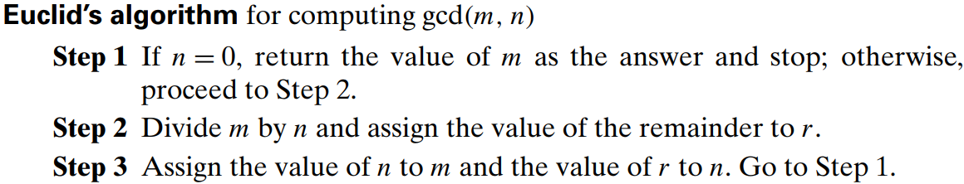
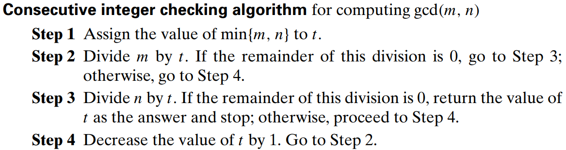
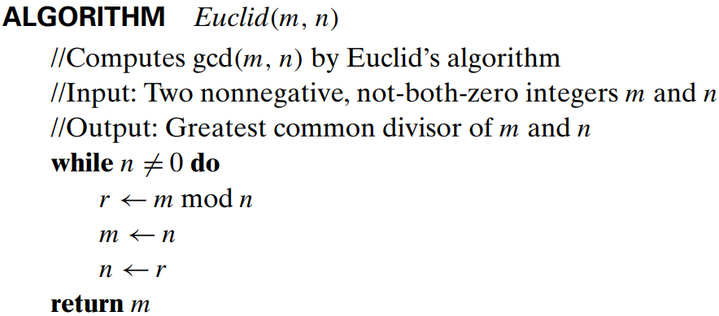
Representation of an Algorithm
An algorithm can be represented in many ways, for example, a GCD aglorithm

Slide 11
Properties of an Algorithm
Input: An algorithm requires one or more inputs. The values that are first supplied to the algorithm before its processing are known as inputs. These inputs come from a predetermined range of acceptable values.
Output: One or more outputs must be produced by an algorithm. The output is the outcome of the algorithm after every step has been completed. The relationship between the input and the result should be clear.
Precision: The steps must be precisely stated.
Finiteness: An algorithm must terminate after a finite number of steps in all test cases. Every instruction which contains a fundamental operator must be terminated within a finite amount of time.
Definiteness: All instructions in an algorithm must be unambiguous, precise, and easy to interpret. By referring to any of the instructions in an algorithm one can clearly understand what is to be done.
Correctness: The algorithm should produce correct results for all possible input data.
Generality: Rather than being limited to a single particular case, an algorithm should be able to solve a group of issues. It should offer a generic fix that manages a variety of inputs inside a predetermined range or domain.

